Slide 1

NIST Immunization Test Suite
Tutorial
Robert Snelick
Sandra Martinez Robles
National Institute of Standards and Technology
November 9, 2015
Contact: rsnelick@nist.gov
Notes:
September

Slide 2
NIST Immunization Test Suite Tool Overview
Tool Key Capabilities
SOAP Envelope Testing | The SOAP Envelop Testing ensures SOAP envelopes are correctly formed, validating the conformance of the messages to the requirements in the SOAP and Transport specifications. This is not used for ONC certification testing.
SOAP Connectivity Testing | The SOAP Connectivity Testing evaluates valid SOAP connectivity, the ability to send and receive SOAP messages, validating the conformance of the messages to the requirements in the SOAP and Transport specifications. This is not used for ONC certification testing.
Context-Free Testing | Provides a simple and convenient method for testing immunization messages structure and most vocabulary. Validation is perform on messages with or without a SOAP wrapper.
Context-Based Testing | Context-based testing provides in addition to HL7 Context-free validation, message validation associated with a given test script that includes data for a specific test scenario where the context is known by the validation tool. It also validate messages with a SOAP wrapper.
Isolated Testing | Isolated testing provides a simulated operational environment that allows validation at the functional level in addition to content and context-free testing, where Test Agents simulates the functions of IZ EHR-S or IIS.
2015 ONC Certified
  Version: v1.0-beta
  Environment: The NIST IZ Test Suite is currently only accessible as a web application.
  Supported Browsers: Firefox, Chrome and Safari
  URL: http://hl7v2-iz-r1.5-testing.nist.gov

Slide 3
HL7 Context-free Testing
Walk Through Tool
Demonstration

Slide 4
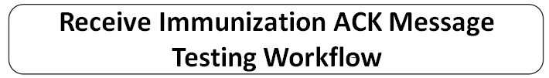



HL7 Message Context-free Validation
Testing Workflow
1. Tester generates HL7 immunization message from the EHR (e.g., SUT).
2. Tester loads message into the Immunization Test Suite.
EHR
5. Tester performs Context-free validation
4. In the Immunization Test Suite, the Tester selects the target Conformance Profile to validate an HL7 message against.
Immunization
Test Suite
7. Tester reviews Errors, Affirmatives, and other Warning/Alert/
.
5. Tester generates Validation Report.
5. Tester analyzes the Validation Report.
Validation Report

Slide 5
HL7 Context-free Testing Work Flow
1) Select HL7 Context-free Conformance Profile
Open the NIST IZ Test Suite using the following link: http://hl7v2-iz-r1.5-testing.nist.gov . Click on the ‘HL7 Context-free’ tab. Select a target ‘Conformance Profile’ from the available options. - Driven from the CDC HL7 Version 2.5.1 Implementation Guide for Immunization Messaging standard.
2) Load an HL7 Message and Execute Validation
Load an HL7 message into the NIST IZ Test Suite’s ‘Message Content’ field. Either through loading the NIST IZ Test Suite’s prepopulated example message (‘Load Example’ button) or an existing message on the Tester’s local machine (‘Browse’ to file or copy/paste the HL7 message into the ‘Message Content’ field). Assure the ‘Message Tree’ is populated with the correct HL7 message elements/segments. Manually validate by selecting the ‘Validate’ button or choose validation frequency for automatic validation.
3) Review Validation Testing Results, Generate Report, and View Data Elements
Within the ‘Message Validation Result’ field, review the validation testing fails (‘Errors’), successes (‘Affirmatives’), and other notifications (‘Warnings’, and ’Alerts’.. Clicking the arrow down expands and collapses the content within the ‘Message Tree’. HL7 message line mappings between the ‘Message Content’ and ‘Message Tree’ fields are highlighted in yellow. Select the ‘Report’ tab to view the ‘Message Validation Report’. Select the ‘Profile Viewer’ to view data elements and table values for a selected target ‘Conformance Profile’. Select the ‘Value Sets’ tab to view the vocabulary requirements for a selected target ‘Conformance Profile’.

Slide 6
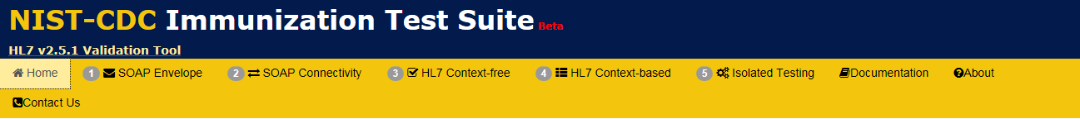
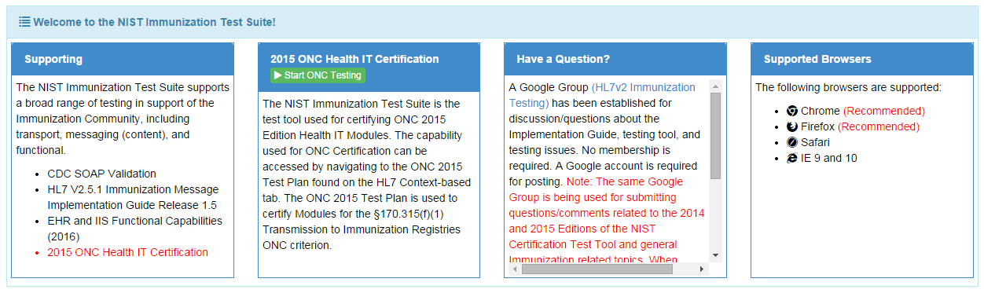
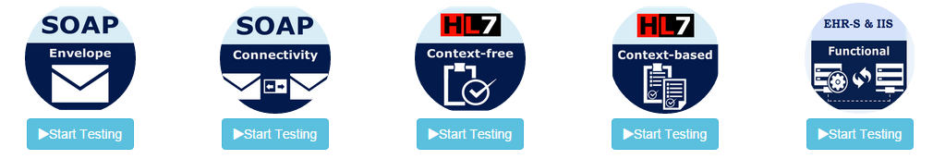
Tool Access and Navigation
Objectives | Informative Reference
Establish access to the NIST IZ Test Suite tool (web application). Locate the Navigation Bar. Locate relevant documentation. Locate the Test Suite. | The NIST IZ Test Suite is accessible through the following URL: http://hl7v2-iz-r1.5-testing.nist.gov. This displays the NIST IZ Test Suite’s Welcome Screen, which is indicated by the ‘Home’ tab. The ‘Documentation’ tab contains relevant downloadable User, Documentation, Resources/Artifacts, and Notations.
1
The tool’s Navigation Bar is located along the top. The options are ‘Home’, ‘SOAP Envelope’, ‘SOAP Connectivity’, ‘HL7 Context free’, ‘HL7 Context-based’, ‘ Isolated Testing’ ‘Documentation’, ‘About’, and ‘Contact Us’.
The Welcome Screen is located under the ‘Home’ tab.
2
Scrolling down the Welcome Screen gives other useful information, such as the NIST IZ Test Suite:
Components;
Focus of Each Testing Stage;
Testing Stage Benefits; and
Testing Types.
Notes:
Image associated with 2 too small to read

Slide 7



Immunization Test Suite: Overview and Capabilities
1
SOAP Envelope Testing
  Validate message to SOAP schema and to CDC WSDL
  [EHR-S and IIS]
2
SOAP Connectivity Testing
  Echo back; Fault generation (Authentication; Message Size, etc.)
  [EHR-S and IIS]
3
HL7
Context-free Testing
  Cut-n-paste; validate message structure and most vocabulary
  [EHR-S and IIS; W/WO SOAP]
4
  Cut-n-paste; validate message against test cases and test data
  [EHR-S and IIS; W/WO SOAP]
HL7
Context-based Testing
5a
EHR-S Functional Testing
Stage-by-stage testing
Start simple and progress
Independent—can enter at any stage
Stage 4 ONC 2015 Certification Test Plan)
Multiple levels within a stage
Detailed test cases and associated data
5
  Interactive round-trip; scenario and functional testing
  [End-to-end Testing]
5b
IIS Functional Testing

Slide 8
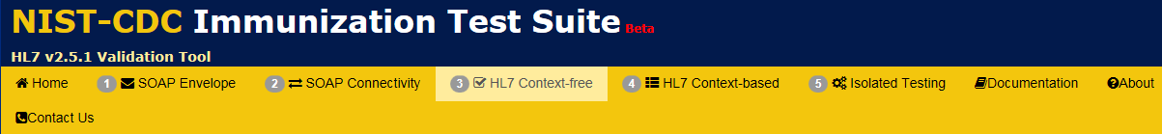
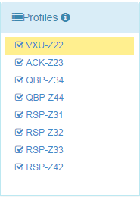
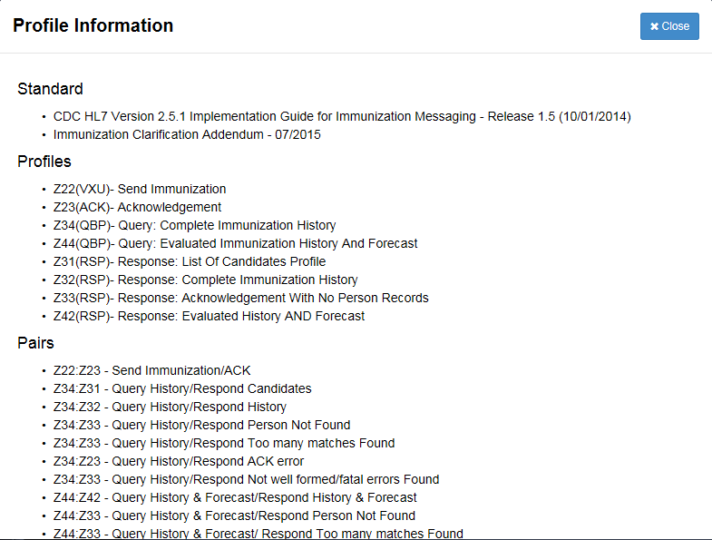
Conformance Profile Selection
Objectives | Informative Reference
Locate the ‘HL7 Context-free’ tab on the Navigation Bar. Locate the NIST IZ Test Suite‘s available ‘Conformance Profiles’. Access additional information on standard / implementation guide documentation and profile linkages. | The ‘HL7 Context-free’ tab contains the target HL7 Context-free testing elements and associated HL7 message validation engine. The ‘Conformance Profiles’ are derived from the CDC HL7 Version 2.5.1 Implementation Guide for Immunization Messaging (current release) document.
3
Select ‘HL7 Context-free’ from the
Navigation Bar.
4
Select the ‘Validation’ tab.
5
5a
Select a ‘Conformance Profile’ to test an HL7 message against.
Selecting the ‘i’ information button expands a detailed reference compendium for the Conformance Profiles.
Refer to CDC HL7 Version 2.5.1 Implementation Guide for Immunization Messaging (current release) for further detailed information
6
Notes:
Images associated with 2, 3, and 4 too small to read

Slide 9
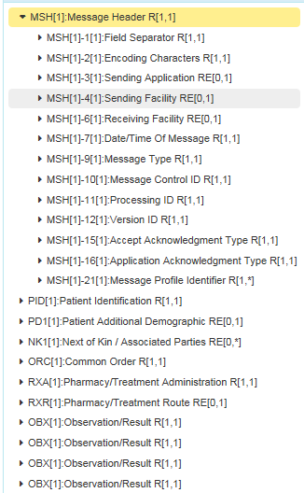
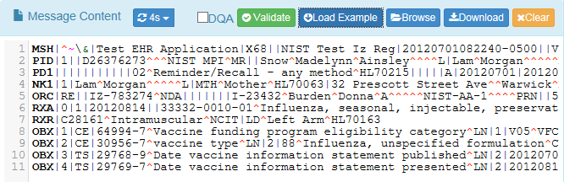
Load HL7 Message
Objectives | Informative Reference
Locate the ‘HL7 Context-free’ tab on the Navigation Bar. Locate and select a profile from the NIST IZ Test Suite‘s available ‘Conformance Profiles’. Load an HL7 message into the NIST IZ Test Suite (either from local storage or by example). | An HL7 message can be loaded directly into the tool’s ‘Message Content’ field by copy/paste, direct from local file, or by default (preloaded and built-in) example. Clicking the ‘Validate’ button performs instant message validation. The Tester can also elect to set an automatic message validation refresh frequency (Disable or 1 to 8 second delay).
7
With a Conformance Profile selected, an HL7 message can be loaded into the ‘Message Content’ field by:
Clicking the ‘Browse’ button to load an existing HL7 message from the Tester’s local machine; or
Clicking the ‘Load Example’ button to populate sample HL7 message.
Clicking the ‘Validation’ button performs message validation against the selected Conformance Profile. The validation frequency can be manipulated from ‘1 to 8 seconds’.
Selecting ‘Download’ allows you to save the HL7 message in a .TXT formatted file on the Tester’s local machine.
Selecting ‘Clear’ clears all HL7 related message data from the Message Content field.
8
When an HL7 message is loaded into the Message Content field, the ‘Message Tree’ is automatically populated with the relevant HL7 message instance segments. Clicking the arrows to expand and contract the segments. Selecting an individual item shows its exact path with the Message Content field and viewable HL7 message (highlighted in yellow).
Notes:
Images with 5, 6, and 7 too small to read

Slide 10
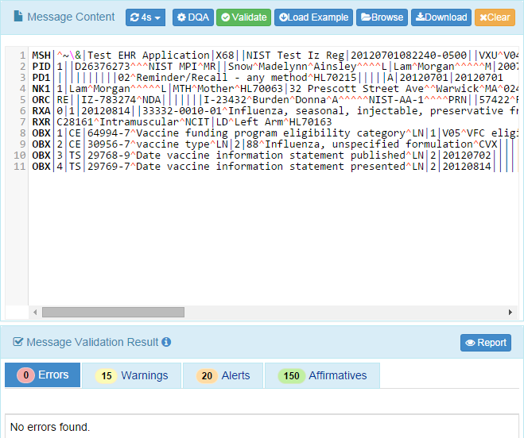
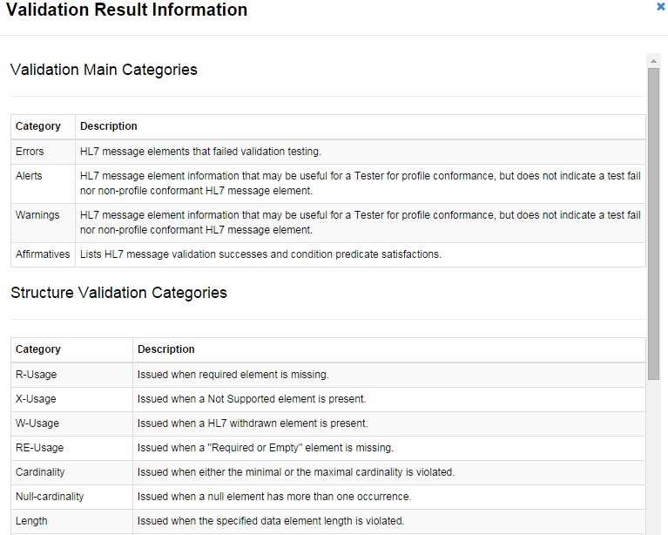
HL7 Message Validation
Objectives | Informative Reference
Locate the ‘HL7 Context-free’ tab on the Navigation Bar . Locate and select a profile from the NIST IZ Test Suite‘s available ‘Conformance Profiles’. Load and validate an HL7 message within the NIST IZ Test Suite. | Performing HL7 message validation generates notifications for the Tester about the test and validation successes/failures. These are indicated as ‘Errors’, ‘Warnings’/’Alerts’, and ‘Affirmatives’.
9a
The HL7 message validation results are displayed within the ‘Message Validation Result’ field. Various testing notifications are generated for the Tester.
The types of notifications are:
‘Errors’ – HL7 message elements that failed validation testing.
‘Warnings’, and ‘Alerts’– HL7 message element information that may be useful for a Tester for profile conformance, but does not indicate a test fail nor non-profile conformant HL7 message element.
‘Affirmatives’ – Lists HL7 message validation successes and condition predicate satisfactions.
The exact HL7 message ‘Line’ and ‘Column’ location where the notification was discovered is displayed, as well as ‘Description’ for why the notification was flagged. Clicking the ‘Path’ highlights in the Message Tree and Message Content fields the HL7 message notification data element. Clicking ‘Details’ displays a popup with additional constraint/code metadata.
Clicking the ‘Report’ button presents the Tester with a consumable Message Validation Report that captures the totality of HL7 Context-free validation for the given HL7 message under test.
9b
The ‘Information Button’ provides Validation Result Information.
Notes:
Fix all images; Sheryl commented too small to read

Slide 11
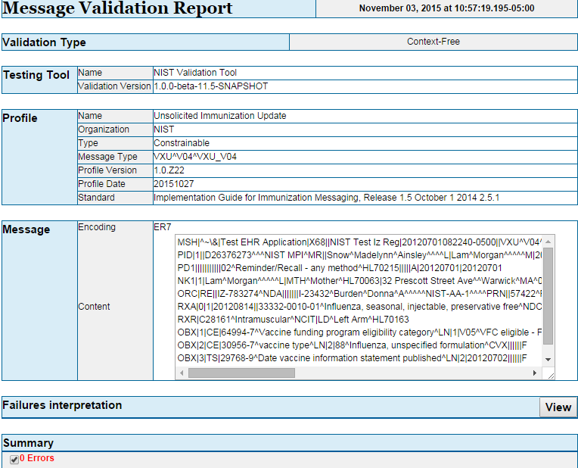
HL7 Message Validation Report
Objectives | Informative Reference
Locate the ‘HL7 Context-free’ tab on the Navigation Bar. Locate and select a profile from the NIST IZ Test Suite‘s available ‘Conformance Profiles’. Load and validate an HL7 message within the NIST Test Suite. Generate and review the ‘Message Validation Report’. | The ‘Message Validation Report’ gives a Tester the complete narrative for a single validation test. Multiple tests cannot be combined together within the report.
10
Select the ‘Report’ tab.
11
The ‘Message Validation Report’ presents the complete results of HL7 message validation testing in an easily consumable format.
Meta such as validation testing type, tool used, and profile used to validate against are included in the report.
A detailed summary of Errors (i.e., validation fails), Alerts, Warnings, Information elements, and Affirmatives (i.e., validation successes and condition predicate satisfactions) are also presented in the report.
Notes:
Fix all images; Sheryl commented too small to read

Slide 12
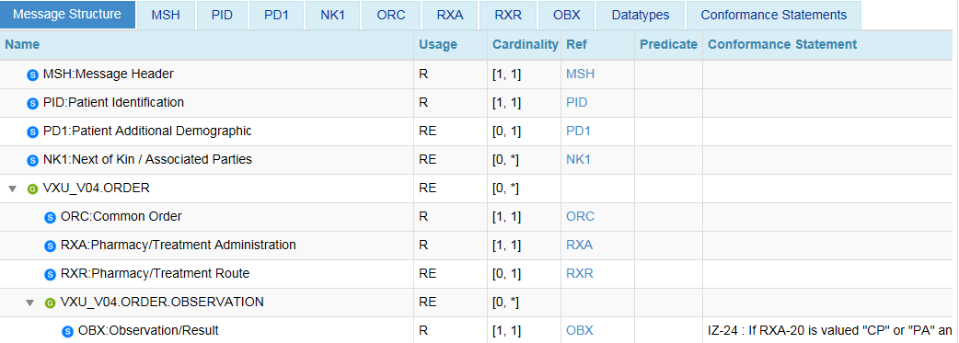
Conformance Profile Data Elements
Objectives | Informative Reference
Locate the ‘HL7 Context-free’ tab on the Navigation Bar. Locate and select a profile from the NIST IZ Test Suite‘s available ‘Conformance Profiles’. Load and validate an HL7 message within the NIST IZ Test Suite. Generate and review the ‘Profile Viewer’. Review HL7 message data type and element requirements. | The ‘Profile Viewer’ gives a Tester the complete standard / implementation guide metadata components that is needed to perform supplemental message validation, error remediation, and troubleshooting.
12
Select the ‘Profile Viewer’ tab.
13
This display presents an interactive interface in which to view data elements and table values for a selected Conformance Profile. The ‘Message Structure’ tab displays data segments for a selected Conformance Profile. Each segment can be filtered by selecting the corresponding tab. Data types are organized based on message ‘Group’, ‘Segment’, ‘Field’, ‘Component’, and ‘Subcomponent’.
Data elements may be filtered according to Usage by selecting either:
‘R, RE, C (only)’ – Required, Required but may be empty, and Conditional; or
or ‘R, RE, C, O, X (All)’ – Required, Required but may be empty, Conditional, Optional, and Not supported.
‘Cardinality’, ‘Data Type’, ‘Length’ (minimum/maximum valid data element length), ‘Value Set’, ‘Condition Predicate’, and ‘Conformance Statement’ fields are also represented for each data element.
Notes:
Fix all images; Sheryl commented too small to read

Slide 13
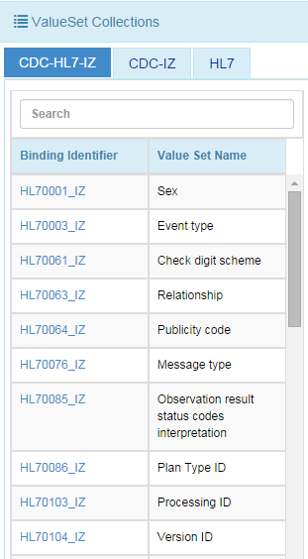
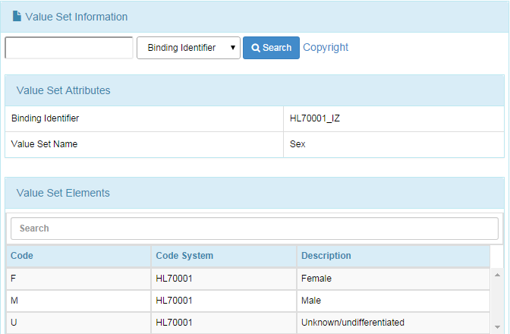
View Conformance Profile Vocabulary
Objectives | Informative Reference
Locate the ‘HL7 Context-free’ tab on the Navigation Bar . Locate and select a profile from the NIST IZ Test Suite‘s available ‘Conformance Profiles’. Load and validate an HL7 message within the NIST IZ Test Suite. Generate and review the ‘Message Validation Report’. Review HL7 message data type and element requirements. Browse HL7 message Value Sets requirements. | The ‘Value Sets’ tab provides the Tester a reference repository for HL7 message and standard / implementation guide driven Value Sets requirements.
14
Select the ‘Value Sets’ tab.
15
This display presents a functional way to browse Conformance Profile Value Sets requirements.
The search feature includes the capability to search based on ‘Binding Identifier’, ‘Value Set Code’, ‘Value Set Name’, and ‘Description’.
.
Notes:
Fix all images; Sheryl commented too small to read

Slide 14
HL7 Context-based Testing
Walk Through Tool
Demonstration

Slide 15
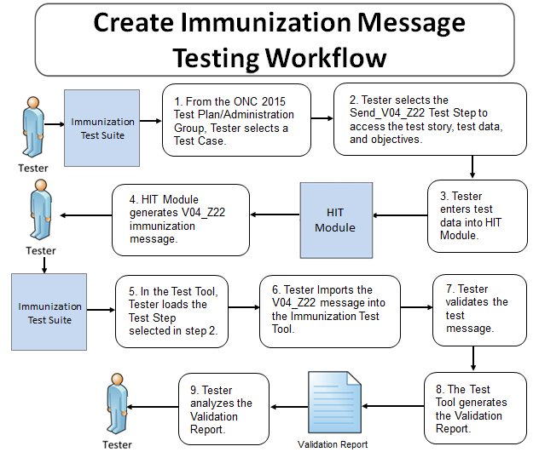
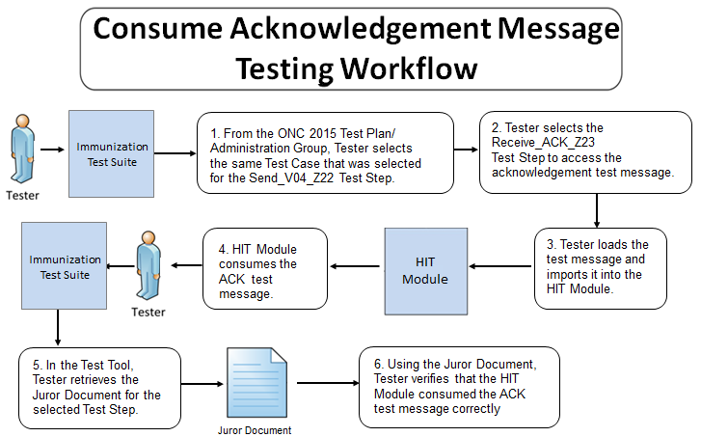
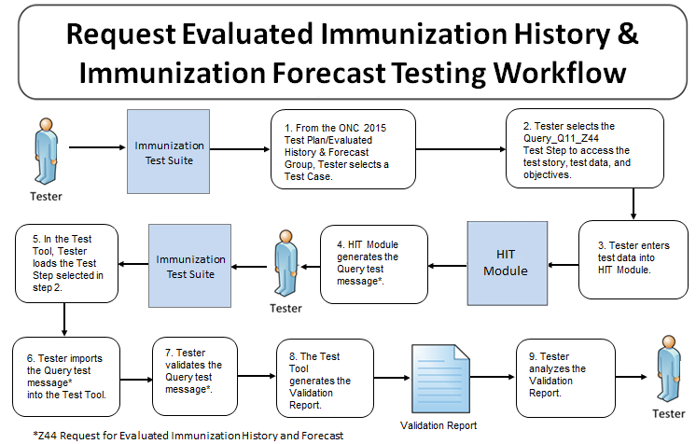
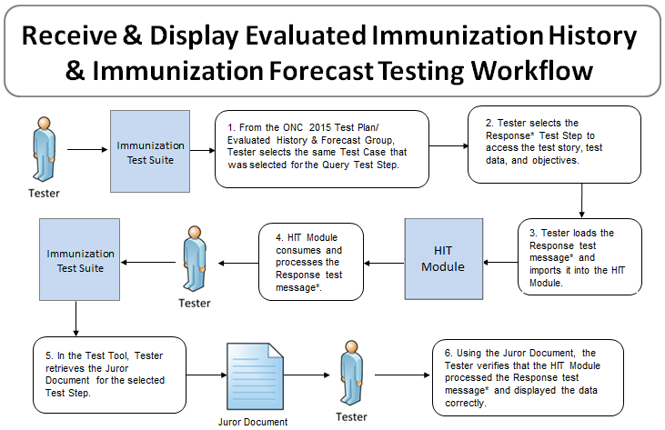
HL7 Message Context-based Validation
Testing Workflow

Slide 16
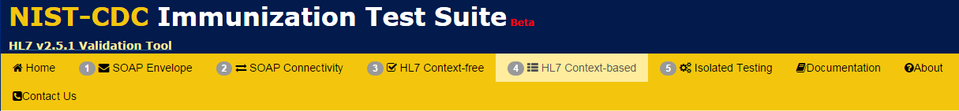
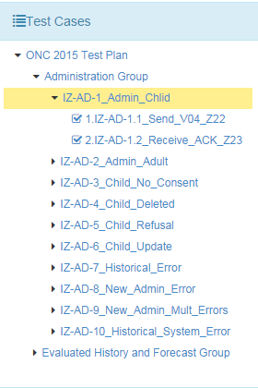
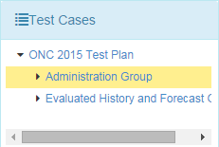
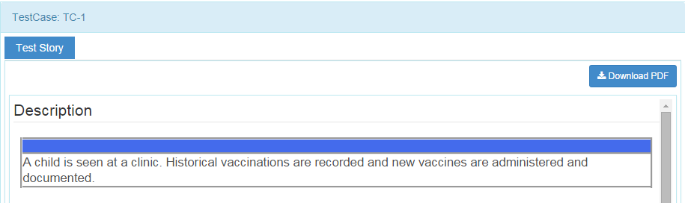
HL7 Context-based Test Case Selection
Objectives | Informative Reference
Locate the ‘HL7 Context-based’ tab on the Navigation Bar. Locate ‘Test Cases’ under the Test Selection Tab. Access additional information on standard / implementation guide documentation and profile linkages. | The ‘HL7 Context-based’ tab contains the target HL7 Context-based testing elements and associated HL7 message validation engine.
1
Select ‘HL7 Context-based’ from the Navigation Bar.
2
3
3a
Select a ‘Test Case’ below the highlighted ‘Test Selection’ tab.
  Arrow down ‘Administration Group’ to choose a test case. The Test Story will be displayed on the right.
  After choosing a test case, arrow down to select a test step.
The ‘Test Story’ provides a Description of what is being tested. Comments, Precondition, Post condition, Test objectives and Evaluation Criteria, are also include as part of the Test Story.
6
Notes:
Images associated with 2, 3, and 4 too small to read

Slide 17
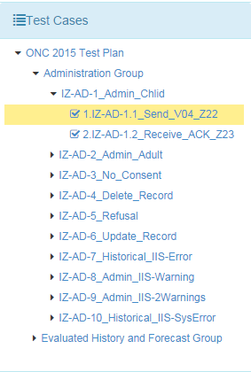
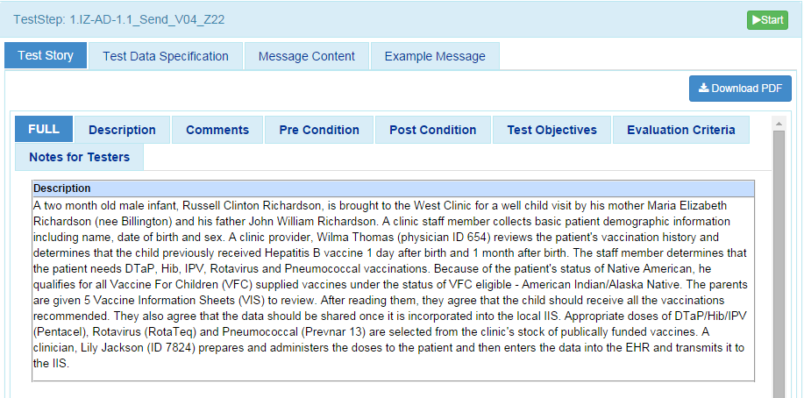
Context-based Message Validation
Objectives | Informative Reference
Locate the ‘HL7 Context-based’ tab on the Navigation Bar. Locate Test Steps, that supports the test cases. Obtain ‘Test Story(s)’ descriptions imitating real world scenarios. | Each Test Step provides unique real world test scenarios that identifies with real world situations. The descriptions are provides under the Test Story tab. Additional Information on the Test Case and/or Test Step is also located under the ‘Test Story’ tab.
4
  Highlight a test step.
7
Click ‘Start’.
5
The highlighted 'Test Step’ will display a Description of the Test Story. The ‘Test Story’ provides a use case scenario.
6
Scroll down to review additional information provided under the ‘Test Story’ tab. Additional information includes: Comments, PreCondition, PostCondition, Test Objectives, Evaluation Criteria, and Notes to Tester.

Slide 18
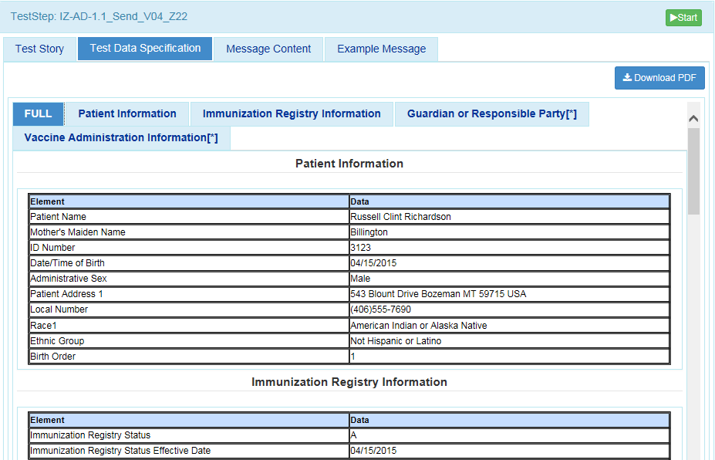
Context-based Message Validation (continued…)
Objectives | Informative Reference
Locate the ‘HL7 Context-based’ tab on the Navigation Bar. Locate ‘Test Data Specification’ tab. Obtain relevant real world clinical data. Download Test Data Specification information. | This page specifies the data that are entered (automatically/manually) into the EHR and included in the message that is created and submitted from the EHR to the Immunization validation tool. The tester shall identify an existing patient record in the EHR or shall create a patient record in the EHR using the data in the Data Sheet associated with the Test Case.
8
11
Click on ‘Test Data Specification’ tab.
Test Data Specification may be downloaded as a PDF file.
9
‘Full’ tab is selected by default. To view a specific section, click on a tab.
10
Relevant real-world clinical data is displayed.

Slide 19
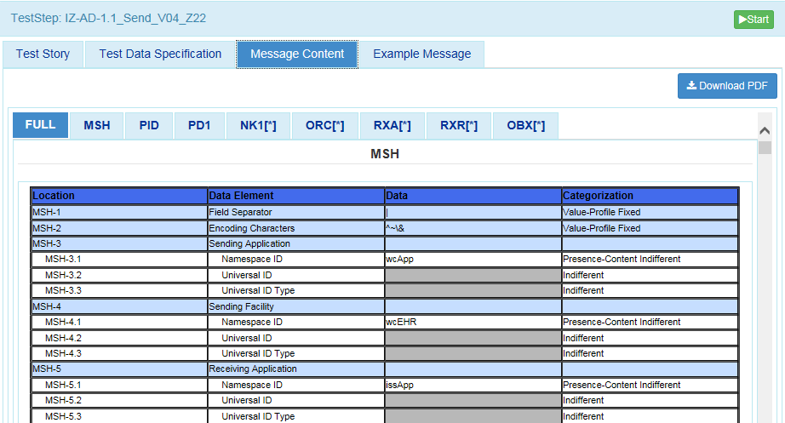
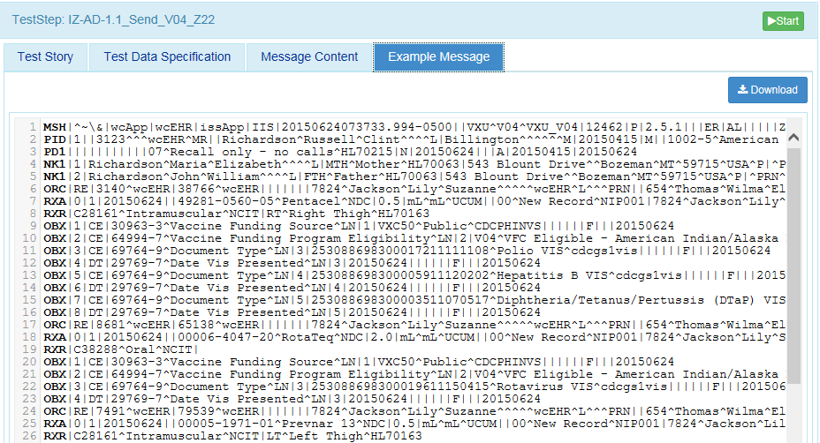
Context-based Message (additional utilities)
Objectives | Informative Reference
Locate the ‘HL7 Context-based’ tab on the Navigation Bar. Locate the ‘Message Content’, that supports the test cases. Using the EHR technology, create the Immunization test message with the test data provided for the selected Test Step. | This page provides details of the message segment, as well as an example of a valid instance of each data element. Message Content or an Example Message can be downloaded as a PDFfile.
12
17
Click on ‘Message Content’ tab.
.
‘Message Content’ or an ‘Example Message’ can be downloaded
13
16
‘Categorization’ indicates if the data is fixed or can be changed. It also indicates the level of validation that will be assessed on the data.
‘Location’ specifies the location of a data element within the message.
14
19
Click ‘Start’
Name of ‘Data Element’ is provided.
15
Exact value of the data element for the selected Test Step is provided. (i.e. age)
18
An example of the HL7 Message is displayed by clicking on ‘Example Message’.

Slide 20
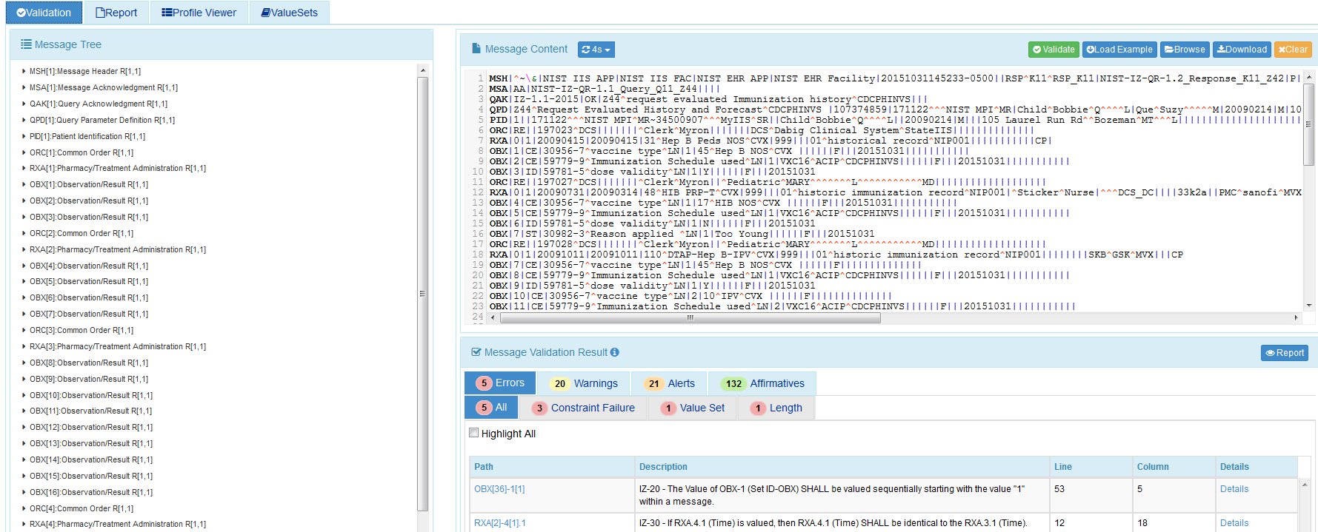
Context-based Testing Message Validation Report
Objectives | Informative Reference
‘Load Example’ HL7 message. ‘Validate’ HL7 Message content. View Validation results. Generate ‘Message Validation Report’. | This page validates any Immunization message created by the EHR. It is disassociated from a test script, test case, or specific content (test data).
20
  Selecting ‘Start’ will send you to the ‘Test Execution’ tab.
25
Click on ‘Report ‘icon to display Message Validation Report.
22
21
Click the Browse button to load an existing HL& message from the testers local machine, or click ‘Load Example’ to populate sample HL7 message. Your message will load in the field provided.
Click ‘Validate’.
23
Total number of errors displays.
24
Validation results appears.

Slide 21
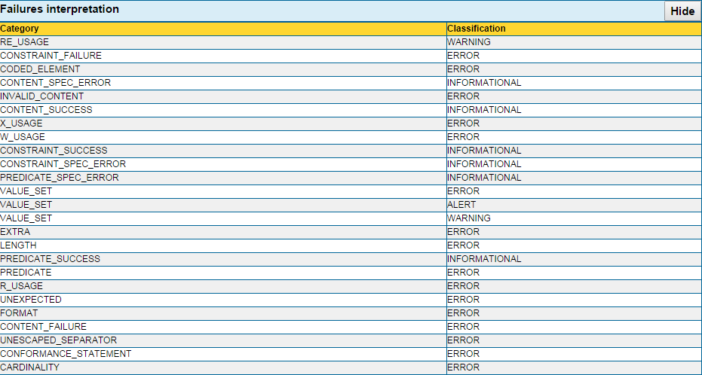
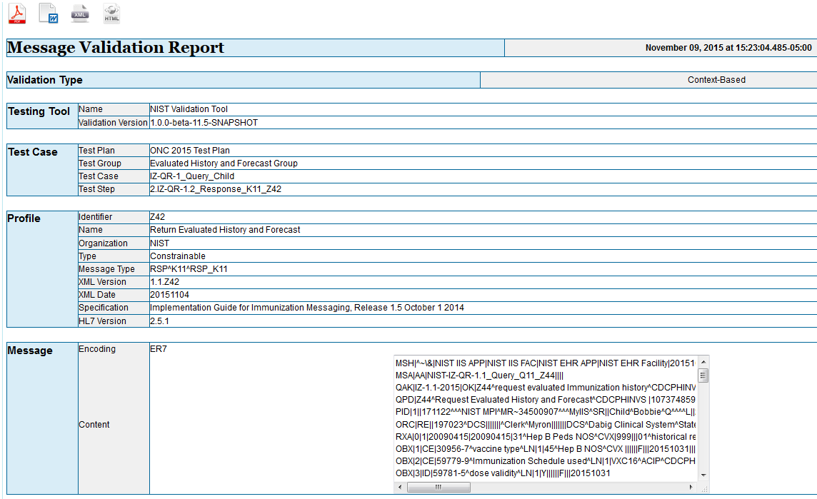
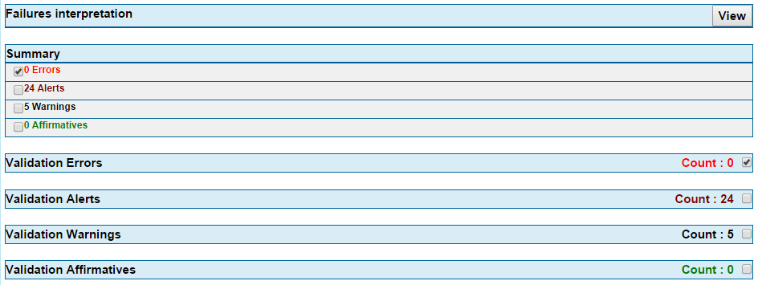
Context-based Testing Message Validation Report (continued…)
26
After clicking ‘Report’, the Message Validation Report will appear.
27
‘Message Validation Report’ may be downloaded as a PDF, XML, Word doc, HTML file.
28
Clicking on the ‘View’ button will show Failure interpretation. This provides classification for types of errors.
29
Note See slides 11-12 for ‘Profile Viewer’ and ‘Value Sets’.

